Slide 1
CAMPUS RECRUITMENT SYSTEM
MINI
PROJECT
Easing you out of the hectic recruitment system

Slide 2

ABOUT US
Sophomores from Indian Institute of Engineering Science and Technology, Shibpur
Department: Information Technology
Batch: 2019-23

Slide 3
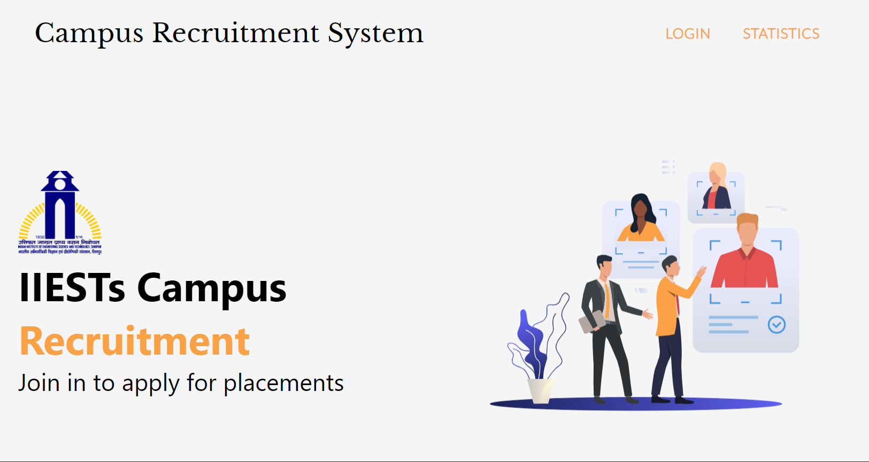
OVERVIEW
A web application for implementing campus recruitment system.
Student Panel for students to register, apply and check status for jobs.
Admin Panel for admins to have a control over the application like posting jobs, changing status of students.

Slide 4

TECH STACK
We have used MERN stack to build this project from scratch.

Slide 5

TECHNICAL DETAILS
Language: Javascript
Database: MongoDB
Backend Framework: ExpressJS
Frontend Library: ReactJS
Server Environment: NodeJS
UI Framework: Material UI

Slide 6
ADVANTAGES
There will be no need of putting up notice or emailing every student about the company coming in college. The students can keep updated themselves through this software.
The admin can view all students' detail and system can shortlist students according to their criteria instead of doing manually.
There is admin login that can view and manage both students and company’s profiles and also can put up job feeds.
Student can register online instead of going to placement department for registration.
This system saves time and efforts.
Our campus recruitment system provides a lot of benefits over traditional placement procedure

Slide 7
STUDENT PANEL
All in one solution for the students for placement season!
1
2
3
Register
Apply For Job
Check Status
It is assured in the application that only students with valid enrolment id can signup in the website.
Complete the registration process by filling the required details and start hunting for jobs.
Check the details of all available jobs from dashboard using available filters like job classification, start date, stipend and more.
Check the status of your application from student dashboard.

Slide 8
ADMIN PANEL
3
2
Update Interview Time
1
A complete dashboard for admin to add jobs, filter students, check profile.
Select Students
Admin can send notifications to all applied students about their interview timings.
Add Jobs
See the list of students who applied for a particular job.
Check their description along with their resume.
Select a student for interview or job or reject him/her. They can check their status from their panel.
Add Jobs with detailed descriptions.
Details like Job title, salary, duration will help in filtering process for students.

Slide 9

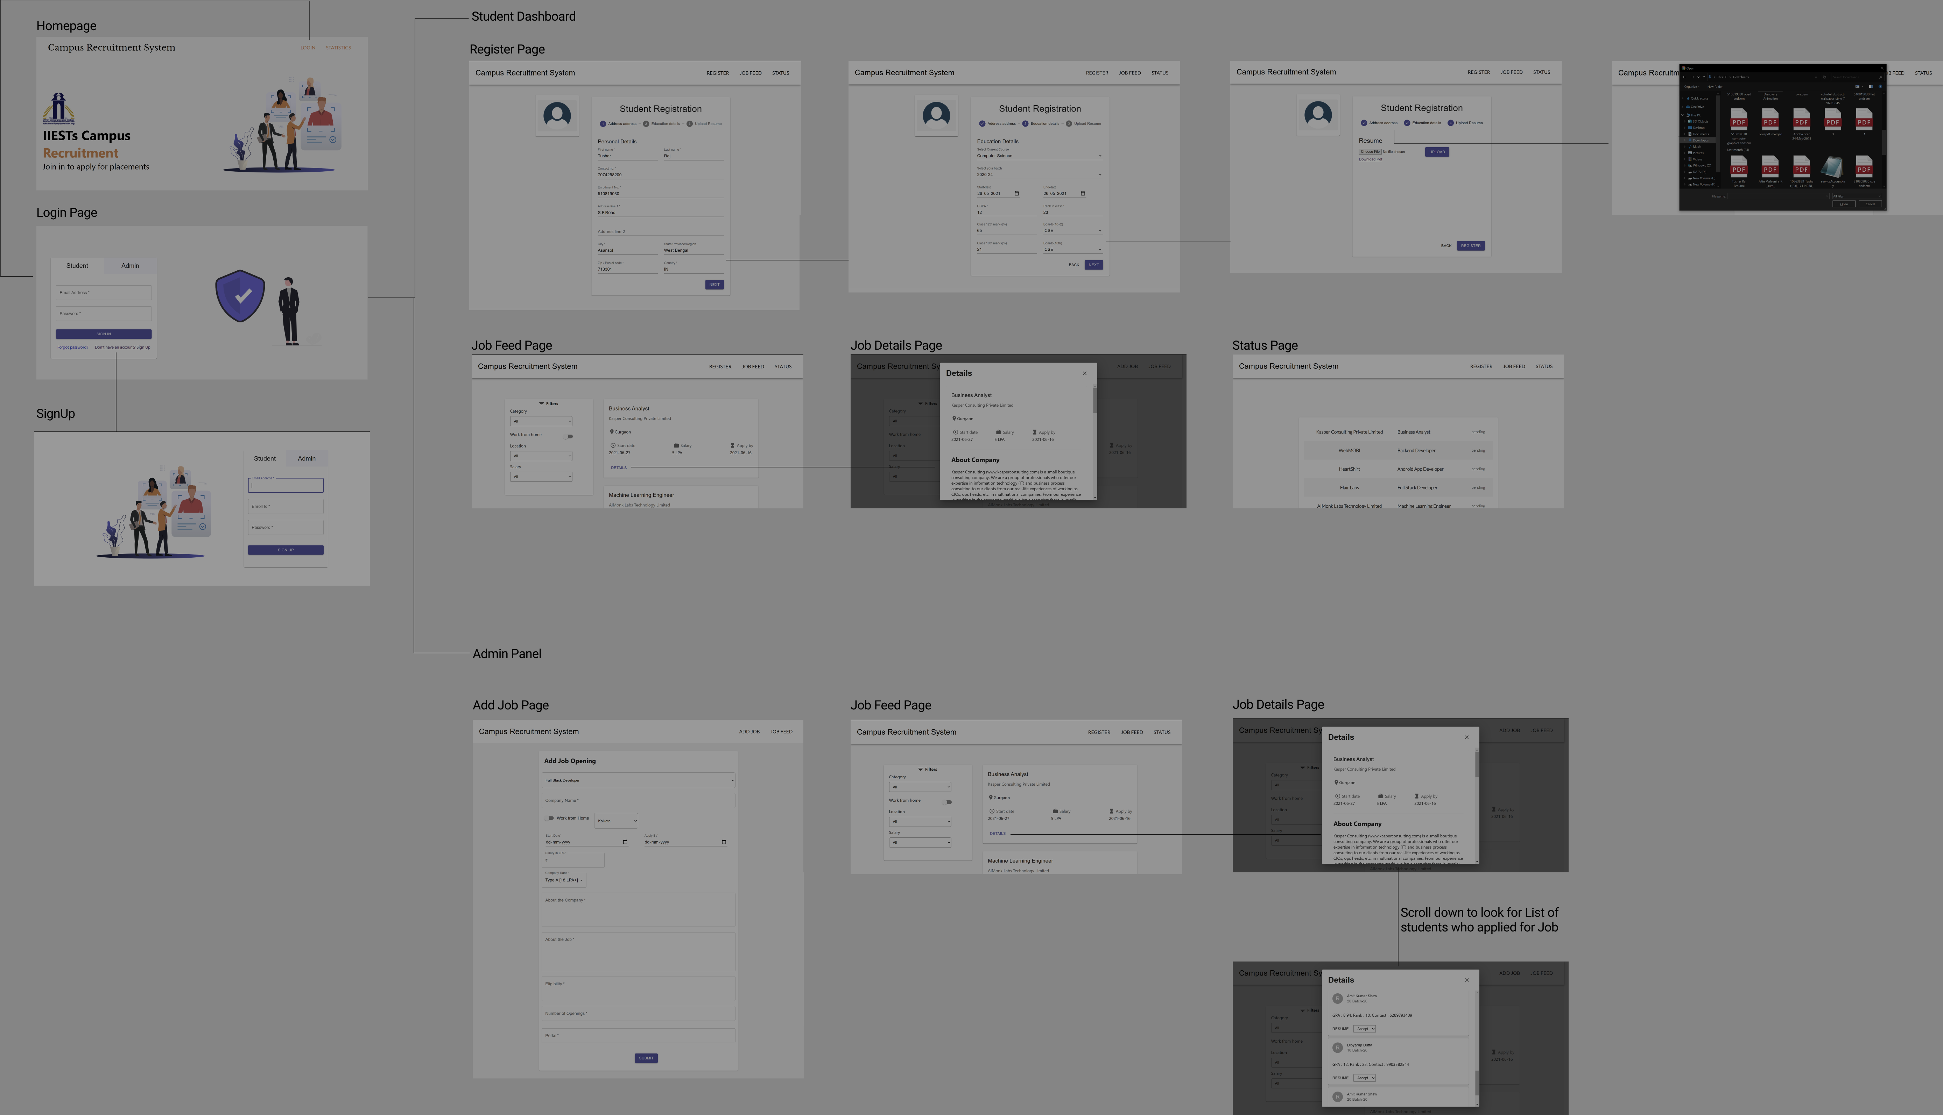
WebFlow
Link to website flow
Preview Of WebFlow

Slide 10
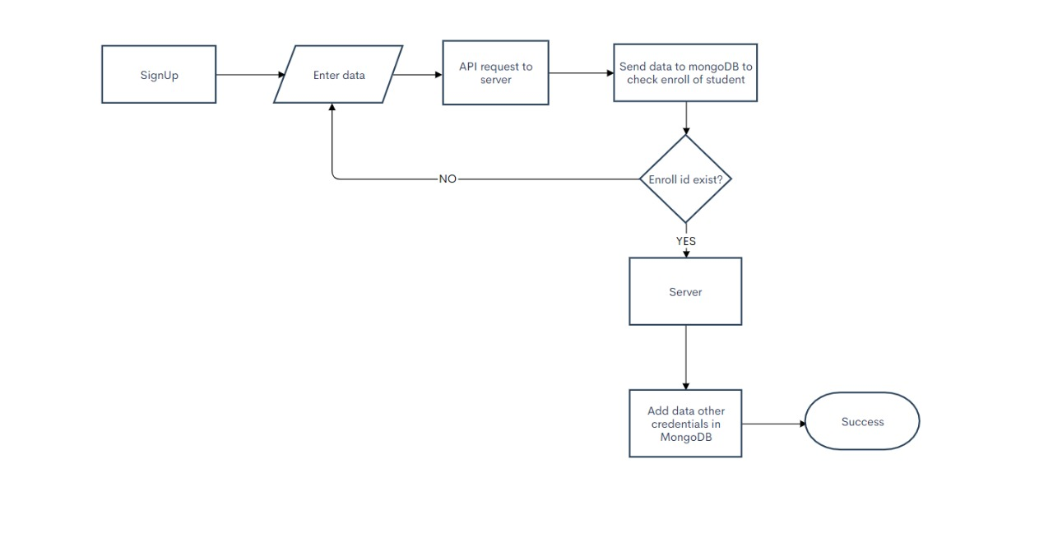
SIGN UP FLOW

Slide 11
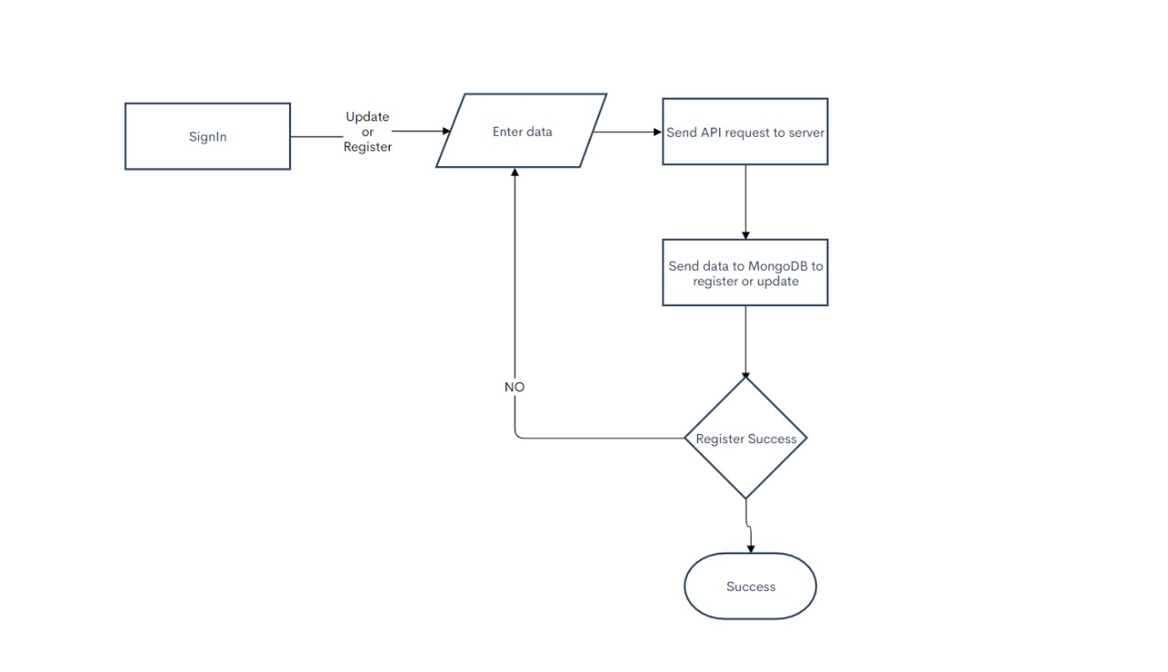
REGISTER FLOW

Slide 12
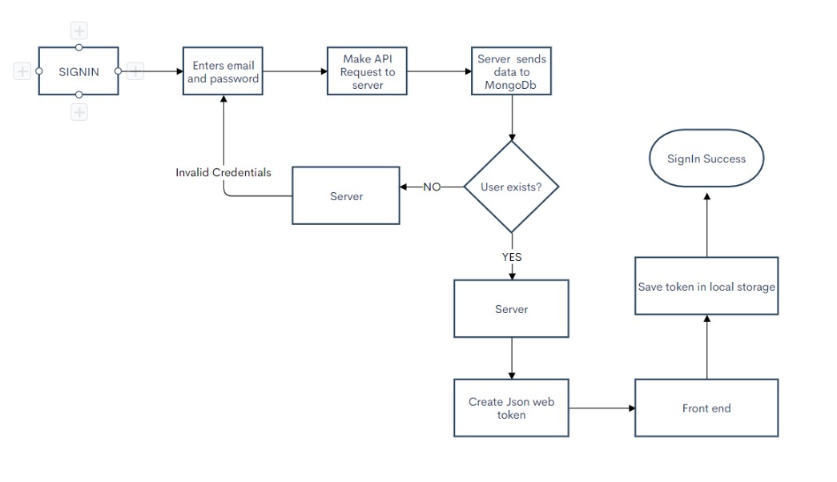
SIGN IN FLOW

Slide 13
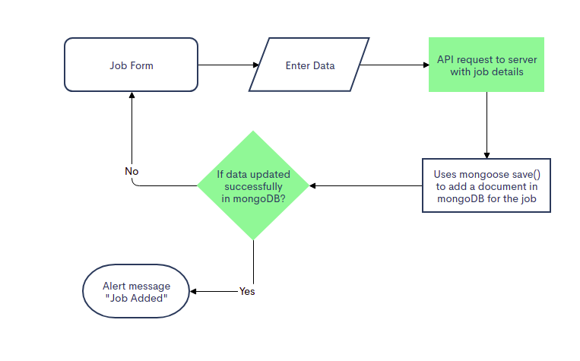
ADD JOB FLOW

Slide 14
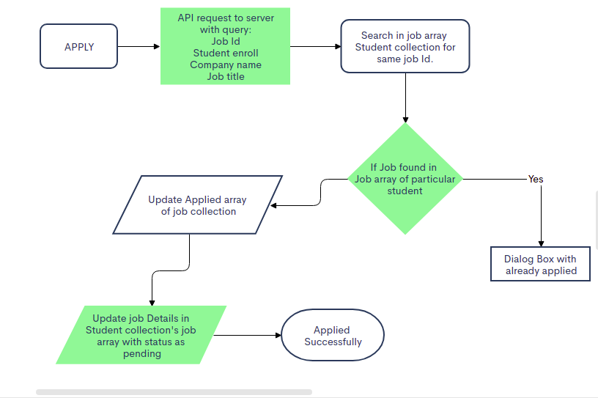
APPLY FOR JOBS FLOW

Slide 15
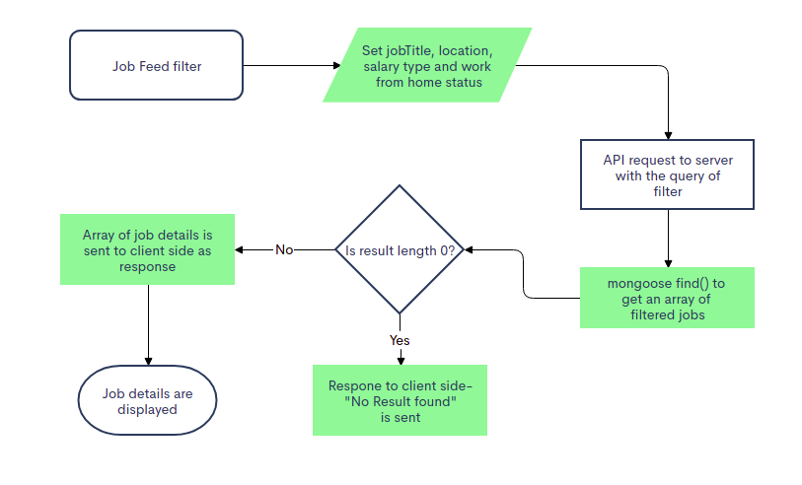
JOB FILTER FLOW

Slide 16
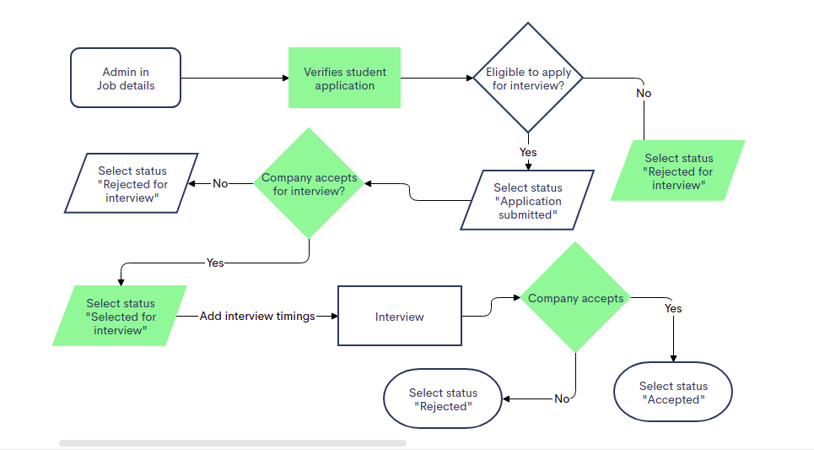
APPLICATION STATUS CHANGE FLOW

Slide 17
OTHER DETAILS
Dependencies Used
Features that will be added in future
Material-ui
Nodemon
React-pdf-viewer
Axios
React-router-dom
Date-fns
Statistics Page: A page available for everyone on the website where they can see the statistics of the placements. Like percentage of student placed, types of companies, number of companies that came, number of students who got multiple offers etc.
Pictorial Representations: Use of graphs, pie charts and histograms to represent different statistics about the placement.

Slide 18

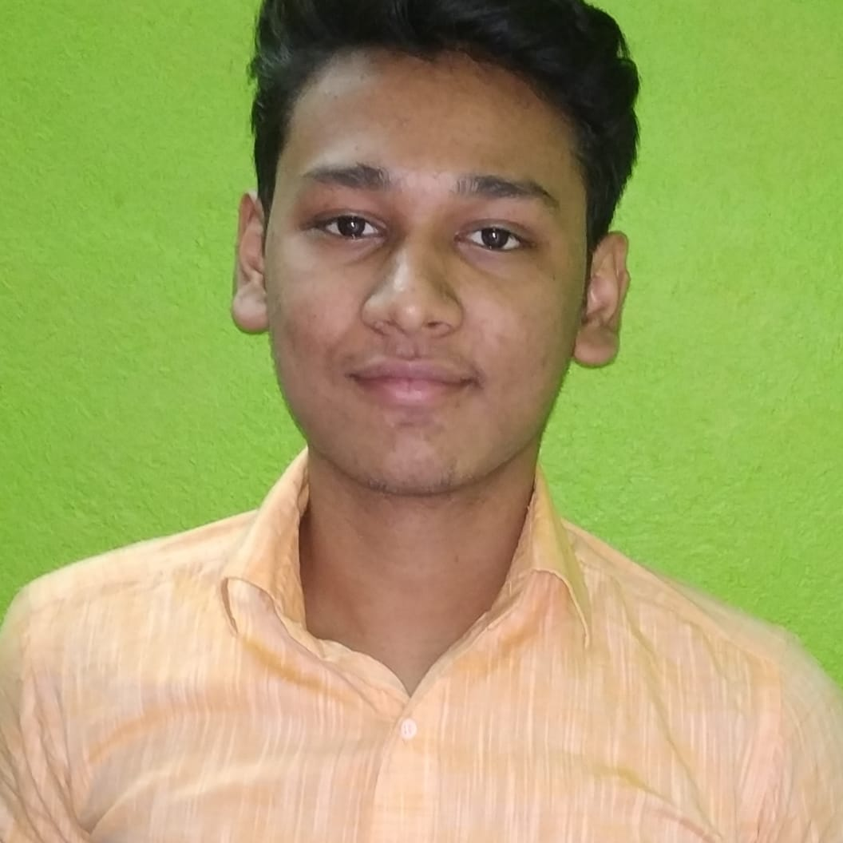
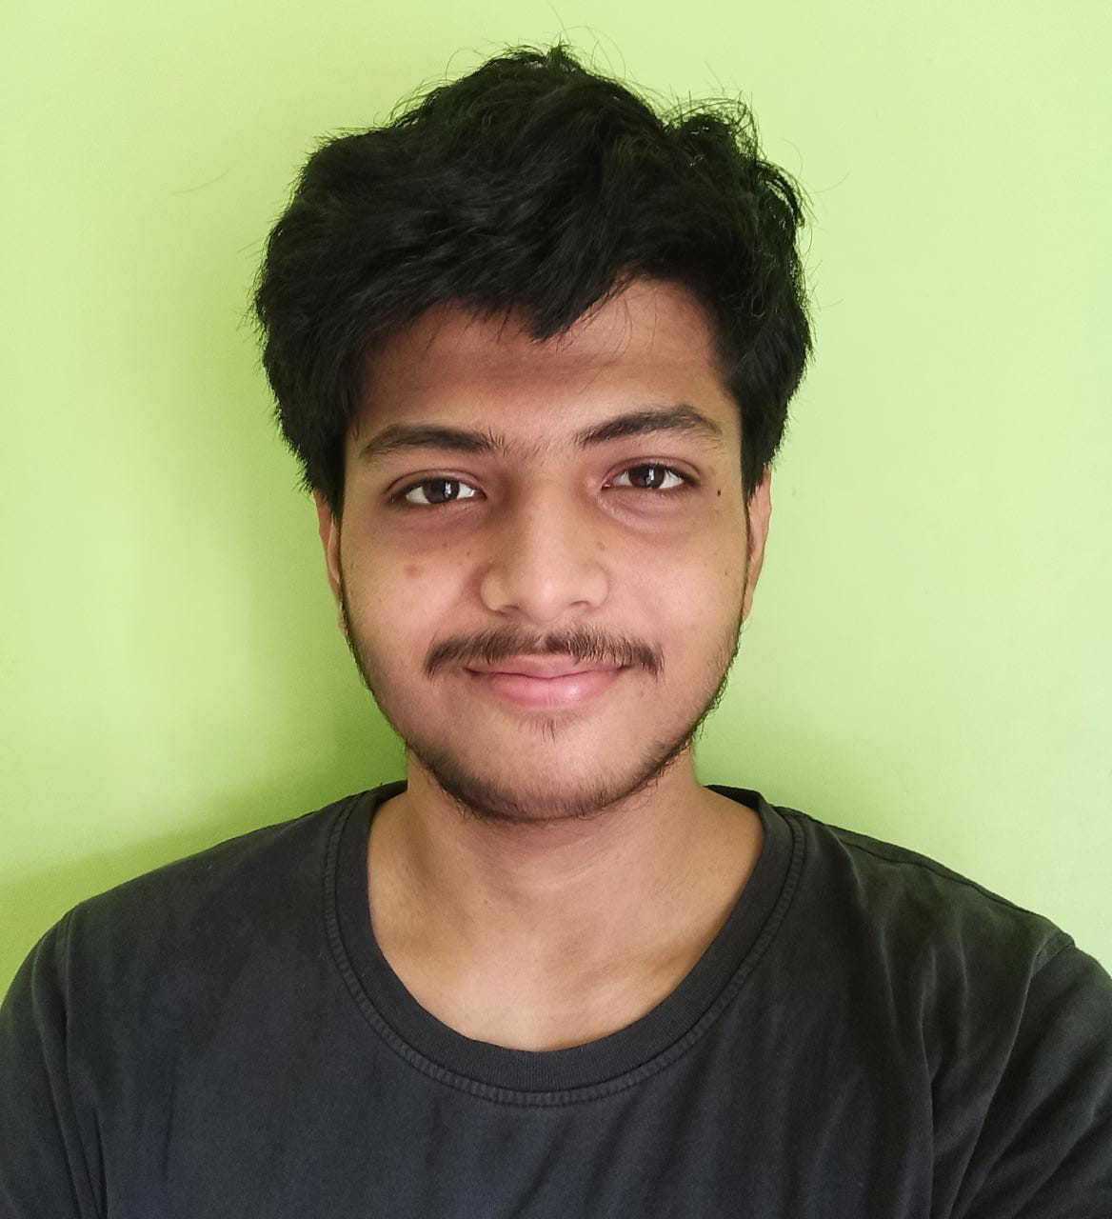
OUR TEAM
Sophomores from Indian Institute of Engineering Science and Technology
Dept: Information Technology
Batch: 2019-23
Tushar
Raj
Amit
Shaw
Dibyarup
Dutta
Enrol Id: 510819030
Enrol Id: 510819012
Enrol Id: 510819047

Slide 19

OUR MENTOR
Mr. Surajit Kumar Roy
Information Technology
Associate Professor +91 - 33 - 26684561/62/63 Ext.
suraroy@gmail.com
Research Areas: 3D IC Testing, Design-for-testability of 3D IC, Reliability and Yield of 3D IC, Hardware Security
Thank you sir for all your support and mentorship !

Slide 20

THANK YOU!
Email Ids:
510819030.tushar@students.iiests.ac.in
510819012.amit@students.iiests.ac.in
510819047.dibyarup@students.iiests.ac.in
Github Repository:
https://github.com/Amit-shaw-404/Campus-Recruitment-System

